Slide 1
Recent Developments in Document Clustering
By
Justice Nii-Ayitey
University of Idaho
11/01/2018

Slide 2
Introduction
Document (or text) clustering is a subset of the larger field of data clustering
Document clustering will therefore be simply referred to as clustering
Clustering should not be confused with classification

Slide 3
Introduction(cont.)
In the context of machine learning, classification is supervised learning and clustering is unsupervised learning
Classification has prior knowledge of classes and classify new sample into known classes and it uses Decision Trees, Bayesian classifiers, etc.
On the other hand, clustering has no prior knowledge of classes and suggest groups based on patterns in data and uses K-means, Expectation Maximization, etc.

Slide 4
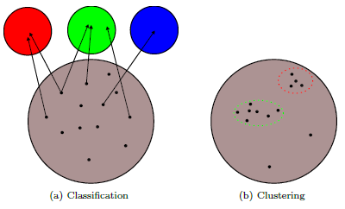

Slide 5
Good, Bad, and Ugly Clustering
Unfortunately, there is little agreement over which is the best way to do so
The choice of evaluation methods frequently depends on the domain in which the research is being conducted
Clustering are good when collections are organized into groups such that each group has similar documents and comparatively different to other groups

Slide 6
Good, Bad, and Ugly Clustering(cont.)
Precision and recall are two intuitive ways to check for performance of clustering
In Information Retrieval, precision (also called positive predictive value) is the fraction of relevant instances among the retrieved instances
Recall (also known as sensitivity) is the fraction of relevant instances that have been retrieved over the total amount of relevant instances

Slide 7
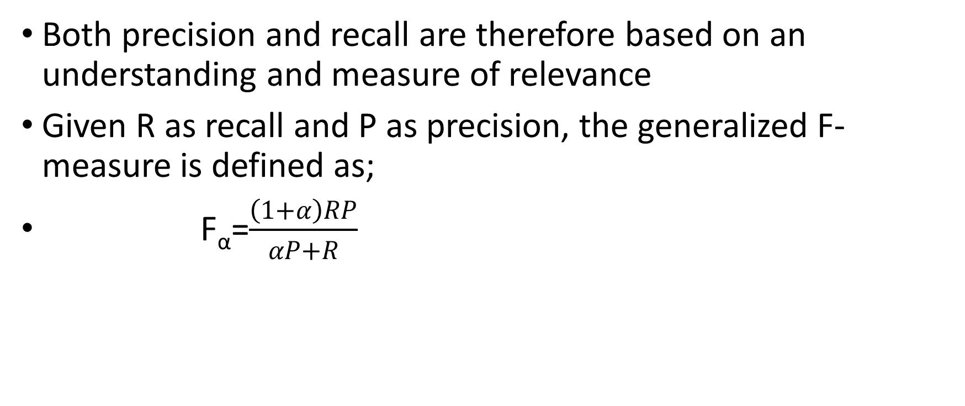
Good, Bad, and Ugly Clustering(cont.)
Both precision and recall are therefore based on an understanding and measure of relevance
Given R as recall and P as precision, the generalized F-measure is defined as;
F_{α}=$\frac{\left(1+α\right)RP}{αP+R}$

Slide 8
Vector Space Model
Most existing clustering approaches choose to represent each document as a vector
This reduces a document to a representation suitable for traditional data clustering approaches
Under the vector model, a collection of n documents with m unique terms is represented as an m*n term-document matrix (where each document is a vector of m dimensions).

Slide 9
Vector Space Model(cont.)
Two important properties
First, in a collection of heterogeneous topics, the number of unique terms will be quite large which results in document vector of high dimensionality
Second, a matrix resulting from a typical corpus under the vector model will be highly sparse
Preprocessing includes filtering, tokenization, stemming, stopword removal, pruning, etc.

Slide 10
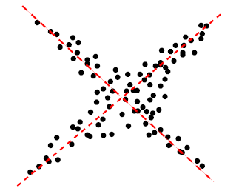
Dimensionality Reduction
Principal component analysis
They are orthogonal (i.e. uncorrelated) projections that together explain the maximum amount of variation in a dataset

Slide 11
Dimensionality Reduction(cont.)
Nonnegative matrix factorization (NMF)
Originally developed for computer vision applications but has been effectively used for document clustering
The technique breaks the original term-document matrix A into the matrices
Soft spectral coclustering
Induces membership weights from the disjoint partitions of words and documents
Lingo
It follows a “description-comes-first" approach to clustering

Slide 12
Extensions to kmeans
Historically, hierarchical and partitional algorithms have been the dominant clustering methods
In hierarchical clustering, each document is initially its own cluster and its algorithms work by successively merging documents
Partitional methods (kmeans) start by choosing k initial documents as Clusters and iteratively assign documents to clusters

Slide 13
Extensions to kmeans (cont.)
Text data is directional, and so it is typical to normalize document vectors, and to use a cosine similarity measure rather than Euclidian distance.
The resulting algorithm is called spherical kmeans
Online spherical kmeans; uses competitive learning techniques to speed up clustering while achieving similar or better accuracy
Kernel kmeans; is to find a mapping to a higher dimensional space where it is more likely that the documents can be linearly separated

Slide 14
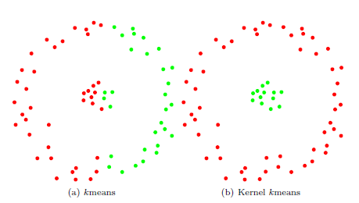
Extensions to kmeans (cont.)

Slide 15
Types of Clustering Algorithms
Clustering algorithms can be divided into two types
Discriminative algorithms ; they classify points without providing a model (i.e. its algorithms operate on pairwise similarities between every document)
Generative algorithms; they assume an underlying distribution of the data (i.e. its algorithms make structure assumptions on the model)

Slide 16
Generative Algorithms
Gaussian model; it represents a dataset as a set of means and covariance matrices
Expectation maximization (EM); this is a procedure to compute a Maximum Likelihood (ML) solution to a model which has two steps
E-step; the missing data is estimated given the observed data
M-step; the likelihood function is maximized under the assumption that the missing data are known
von Mises-Fisher model (vMF); its distribution is the analogue of the Gaussian distribution for directional data
Model-based kmeans; this is a more constrained (disjoint) version of the EM algorithm
This algorithm alternates between a model re-estimation step and a sample re-assignment step, resulting in runtime complexity

Slide 17
Spectral Clustering
A matrix is a natural representation for adjacency information between vertices, and therefore the vector model can be interpreted as a graph
Spectral clustering involves finding cuts (e.g. ratio cut, normalized cut, and min-max cut) in graphs to produce good clusters (i.e. its algorithm aims to optimize). Examples are:
Divide & merge clustering; measures “how tightly nit" a graph is and has been proposed as a criterion for finding optimal cuts in a graph
Fuzzy coclustering; regular fuzzy clustering algorithms capture the degree to which documents belong to each cluster while fuzzy coclustering assigns degrees of membership to words as well

Slide 18
Phrase-Based Models
They naturally describe clusters by phrases and it is generally agreed that these are more descriptive of the cluster contents. Examples are:
Suffix tree clustering (STC) ; was developed for web snippet clustering and uses the tokens output from the preprocessing phase to construct a suffix tree structure
Document index graph (DIG); it is similar to the suffix tree model, but it encodes word order information and defines similarity based on matches in word order

Slide 19
Comparative Analysis
Focus is to describe which techniques are appropriate for query clustering and clustering static collections
Query clustering refers to the grouping documents returned from an IR query, such as a Google search, into clear equivalence classes
Collection clustering refers to the grouping of documents in a static collection

Slide 20
Summary
Clustering algorithms have been evaluated in many ways
There are many amount of literature on clustering
Unfortunately, there is little agreement over which is the best way to do so
The choice of evaluation methods frequently depends on the domain in which the research is being conducted
“clustering is ultimately in the eye of the beholder”
Thank you.

